Slide 1
Is Early Classification of Time Series ever Meaningful?
Renjie Wu, Audrey Der, and Eamonn J. Keogh
TEASER [1] on GunPoint [2] + RandomWalk dataset
Dear Reader,
This presentation contains the results for the test mentioned in Appendix B: 2nd Q&A.
In some cases, we give some text or comments. In others, we just do a screen dump of a MATLAB figure.
The code and datasets for testing TEASER are available on the supporting page [3].
[1] P. Schäfer and U. Leser, “TEASER: Early and Accurate Time Series Classification,” Data Mining and Knowledge Discovery, vol. 34, no. 5, pp. 1336-1362, 2020.
[2] H.A. Dau et al., “The UCR Time Series Classification Archive,” Oct. 2018; https://www.cs.ucr.edu/~eamonn/time_series_data_2018/
[3] R. Wu, A. Der, and E.J. Keogh, “Supporting Page for Is Early Classification of Time Series ever Meaningful,” Feb. 2021; https://wu.renjie.im/research/ETSC-is-meaningless/

Slide 2
Slides 3 to 18:
  TEASER produces confident classifications on data it was not trained on.
  For example, train on GunPoint, test on RandomWALK (next 17 slides)
Slides 20 to end:
  The output of TEASER on GunPoint and mostly works well.
  But there are a good few where TEASER makes a prediction, then immediately changes its mind.
  For these exemplars, we marked them with a yellow square at the top-left coroner.
Works well
Immediately changes its mind after prediction made

Slide 3
For GunPoint
for 10000 times…
% Make a random walk of the size of GunPoint:
d=cumsum(randn(150,1));
% … then test it on the TEASER model
end
Record
How often does it do an early prediction? See right
What was the earliest prediction? 23 datapoints
What is the highest percentage confidence we see? 99.85% (38 datapoints)
Save 4 or 5 images of early predictions and/or highest percentage confidence. Be sure to also save the random walks.
See following slides

Slide 4
Examples (23 datapoints seen)
What is the classifier?
TEASER
What is the training dataset?
GunPoint (50 samples of length 150)
What is the testing dataset?
RandomWalk of d=cumsum(randn(150,1));
How many datapoints have been seen when early classification made?
23 datapoints
What is the probability for the predicted label?
98.45%

Slide 5
Examples (23 datapoints seen)
What is the classifier?
TEASER
What is the training dataset?
GunPoint (50 samples of length 150)
What is the testing dataset?
RandomWalk of d=cumsum(randn(150,1));
How many datapoints have been seen when early classification made?
23 datapoints
What is the probability for the predicted label?
98.44%

Slide 6
Examples (23 datapoints seen)
What is the classifier?
TEASER
What is the training dataset?
GunPoint (50 samples of length 150)
What is the testing dataset?
RandomWalk of d=cumsum(randn(150,1));
How many datapoints have been seen when early classification made?
23 datapoints
What is the probability for the predicted label?
97.81%

Slide 7
Examples (23 datapoints seen)
What is the classifier?
TEASER
What is the training dataset?
GunPoint (50 samples of length 150)
What is the testing dataset?
RandomWalk of d=cumsum(randn(150,1));
How many datapoints have been seen when early classification made?
23 datapoints
What is the probability for the predicted label?
97.63%

Slide 8
Examples (23 datapoints seen)
What is the classifier?
TEASER
What is the training dataset?
GunPoint (50 samples of length 150)
What is the testing dataset?
RandomWalk of d=cumsum(randn(150,1));
How many datapoints have been seen when early classification made?
23 datapoints
What is the probability for the predicted label?
96.83%

Slide 9
Examples (30 datapoints seen)
What is the classifier?
TEASER
What is the training dataset?
GunPoint (50 samples of length 150)
What is the testing dataset?
RandomWalk of d=cumsum(randn(150,1));
How many datapoints have been seen when early classification made?
30 datapoints
What is the probability for the predicted label?
99.77%

Slide 10
Examples (30 datapoints seen)
What is the classifier?
TEASER
What is the training dataset?
GunPoint (50 samples of length 150)
What is the testing dataset?
RandomWalk of d=cumsum(randn(150,1));
How many datapoints have been seen when early classification made?
30 datapoints
What is the probability for the predicted label?
99.16%

Slide 11
Examples (30 datapoints seen)
What is the classifier?
TEASER
What is the training dataset?
GunPoint (50 samples of length 150)
What is the testing dataset?
RandomWalk of d=cumsum(randn(150,1));
How many datapoints have been seen when early classification made?
30 datapoints
What is the probability for the predicted label?
98.68%

Slide 12
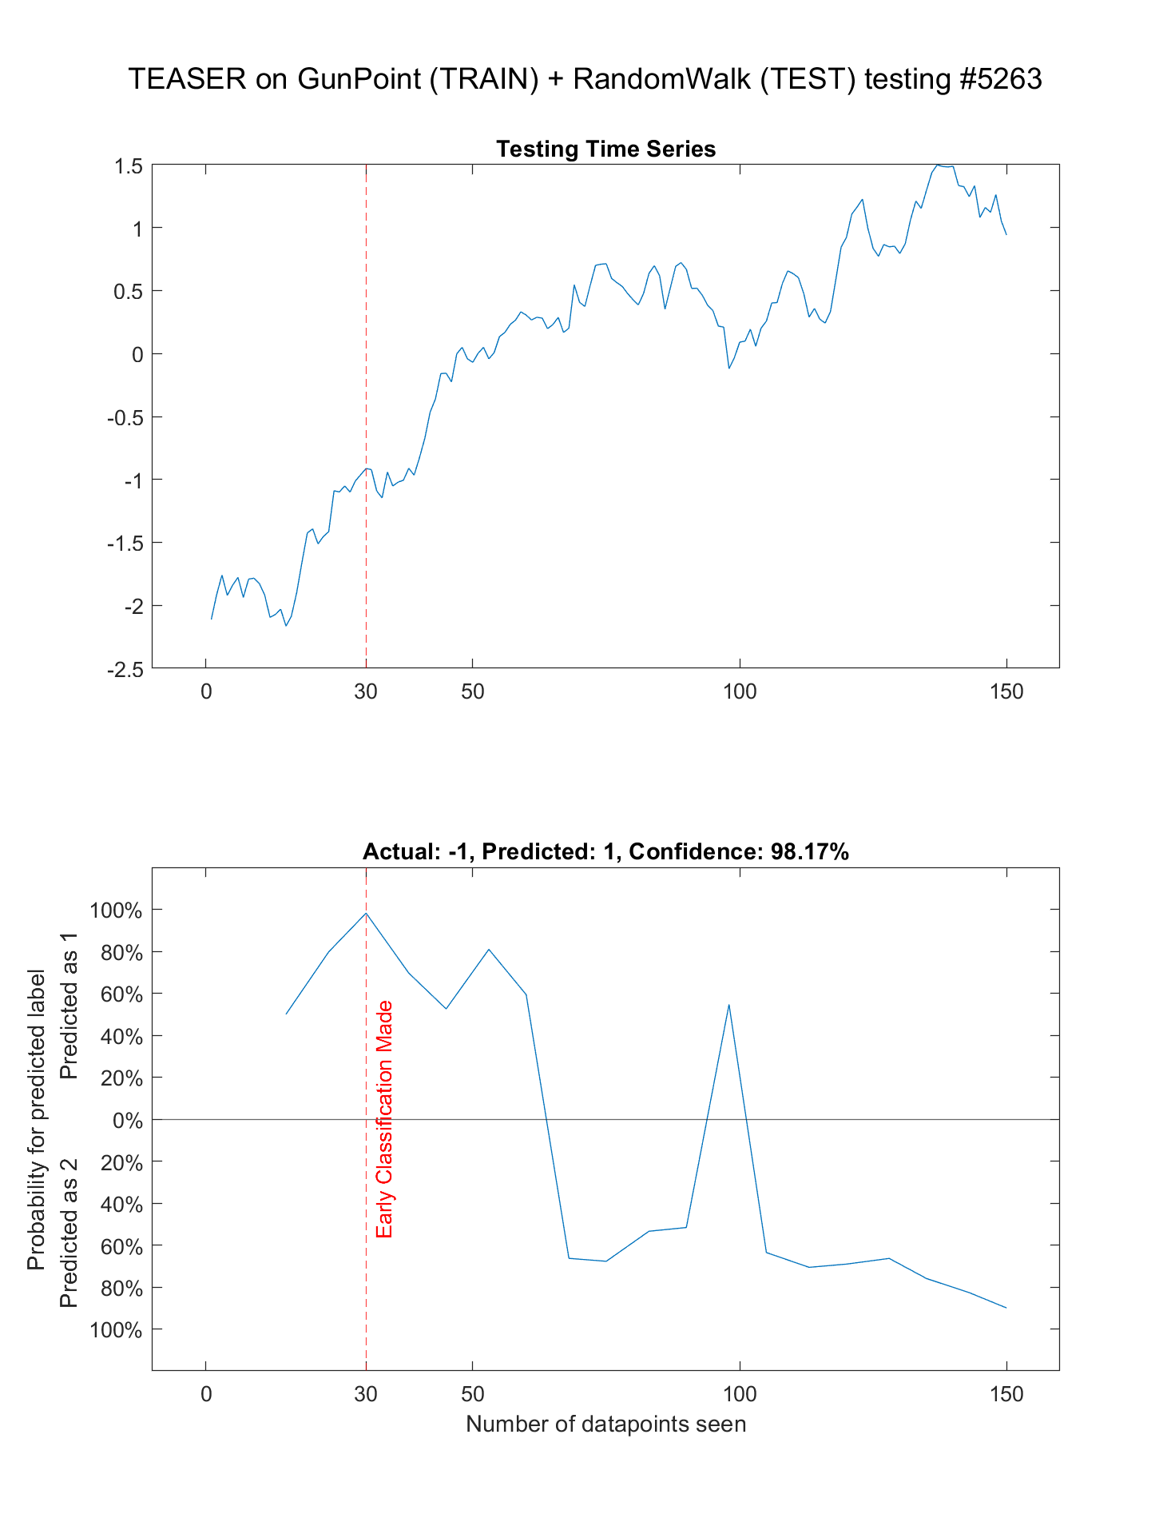
Examples (30 datapoints seen)
What is the classifier?
TEASER
What is the training dataset?
GunPoint (50 samples of length 150)
What is the testing dataset?
RandomWalk of d=cumsum(randn(150,1));
How many datapoints have been seen when early classification made?
30 datapoints
What is the probability for the predicted label?
98.17%

Slide 13
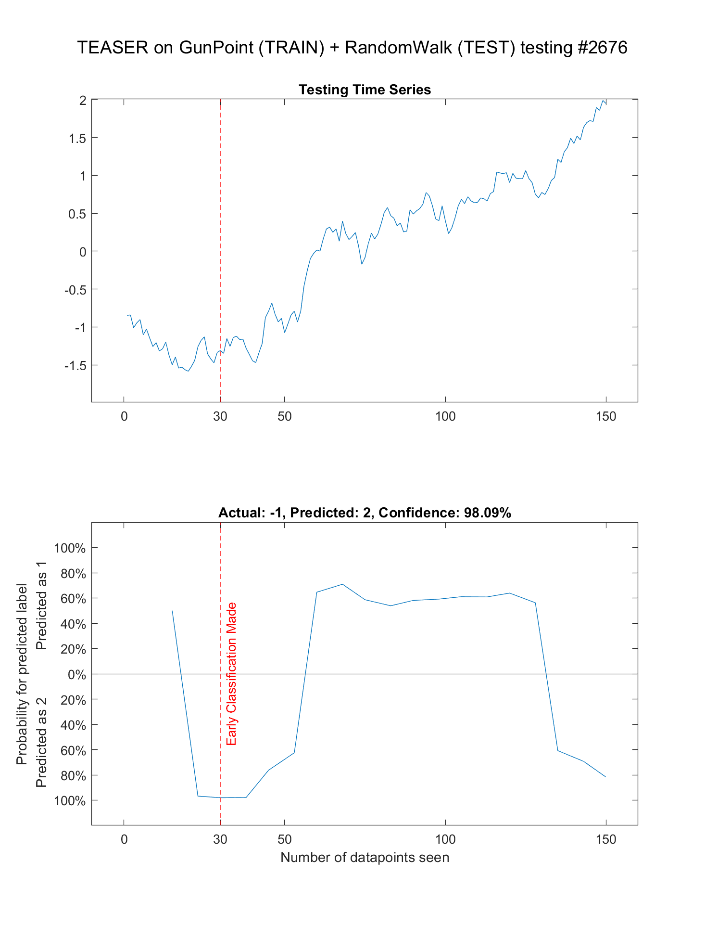
Examples (30 datapoints seen)
What is the classifier?
TEASER
What is the training dataset?
GunPoint (50 samples of length 150)
What is the testing dataset?
RandomWalk of d=cumsum(randn(150,1));
How many datapoints have been seen when early classification made?
30 datapoints
What is the probability for the predicted label?
98.09%

Slide 14
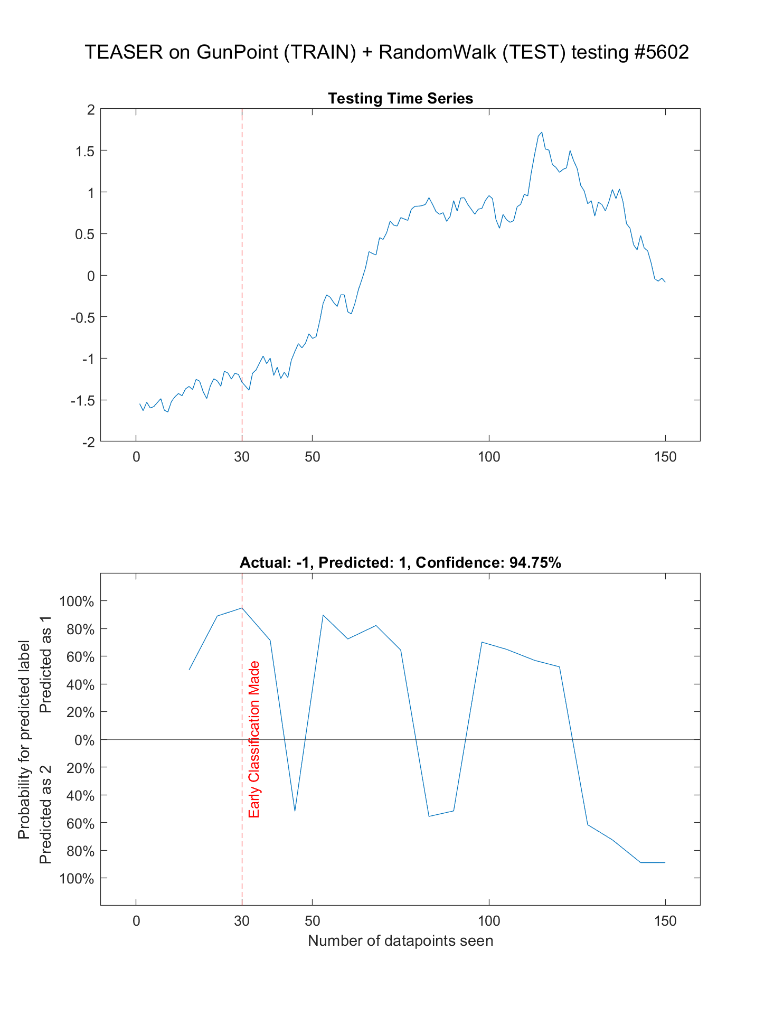
Examples (30 datapoints seen)
What is the classifier?
TEASER
What is the training dataset?
GunPoint (50 samples of length 150)
What is the testing dataset?
RandomWalk of d=cumsum(randn(150,1));
How many datapoints have been seen when early classification made?
30 datapoints
What is the probability for the predicted label?
94.75%

Slide 15
Examples (38 datapoints seen)
What is the classifier?
TEASER
What is the training dataset?
GunPoint (50 samples of length 150)
What is the testing dataset?
RandomWalk of d=cumsum(randn(150,1));
How many datapoints have been seen when early classification made?
38 datapoints
What is the probability for the predicted label?
99.85%

Slide 16
Examples (38 datapoints seen)
What is the classifier?
TEASER
What is the training dataset?
GunPoint (50 samples of length 150)
What is the testing dataset?
RandomWalk of d=cumsum(randn(150,1));
How many datapoints have been seen when early classification made?
38 datapoints
What is the probability for the predicted label?
98.77%

Slide 17
Examples (38 datapoints seen)
What is the classifier?
TEASER
What is the training dataset?
GunPoint (50 samples of length 150)
What is the testing dataset?
RandomWalk of d=cumsum(randn(150,1));
How many datapoints have been seen when early classification made?
38 datapoints
What is the probability for the predicted label?
96.63%

Slide 18
Examples (38 datapoints seen)
What is the classifier?
TEASER
What is the training dataset?
GunPoint (50 samples of length 150)
What is the testing dataset?
RandomWalk of d=cumsum(randn(150,1));
How many datapoints have been seen when early classification made?
38 datapoints
What is the probability for the predicted label?
96.38%

Slide 19
Slides 3 to 18:
  TEASER produces confident classifications on data it was not trained on.
  For example, train on GunPoint, test on RandomWALK (next 17 slides)
Slides 20 to end:
  The output of TEASER on GunPoint. Mostly works well.
  But there are a good few where TEASER makes a prediction, then immediately changes its mind.
  For these exemplars, we marked them with a yellow square at the top-left coroner.
Works well
Immediately changes its mind after prediction made

